Slide 1

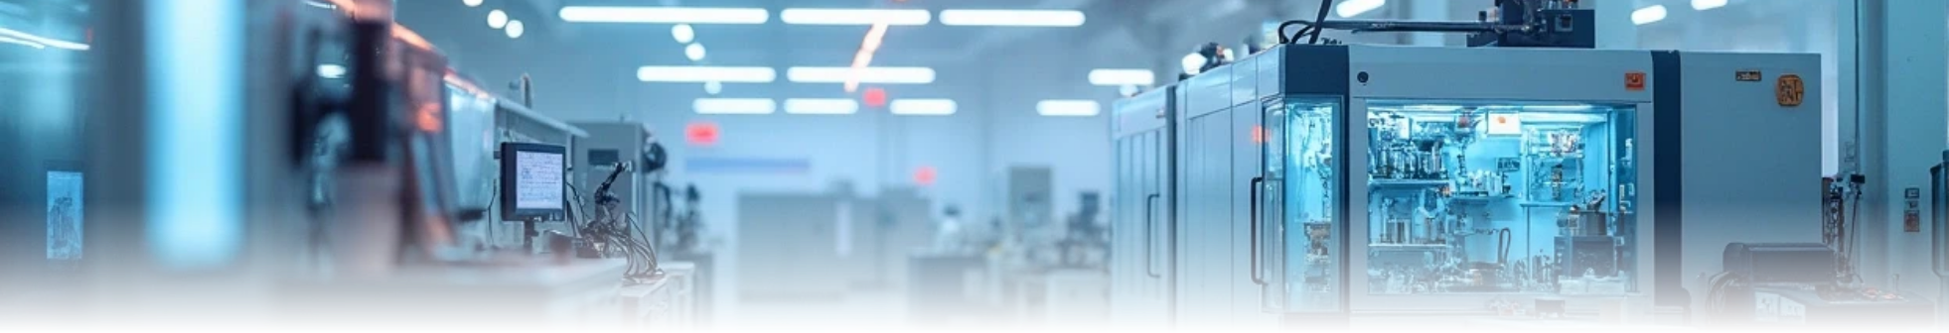
Cyber-Physical Molding Station with Integrated IoT Monitoring and Secure Access

Slide 2

CONTENTS
1. Introduction
2. System Overview
3. Node Architecture
4. Functional Workflow
5. Key Features
6. Hardware & Software
7. Applications
8. Future Enhancements

Slide 3

01
Introduction

Slide 4

Introduction
This project implements Cyber-Physical System (CPS) for a smart molding station. The system integrates 8 nodes for real-time monitoring, control, and security of environmental parameters, machine health, and automated material handling. A 3D digital twin visualizes the live data and enforces bidirectional feedback, ensuring that access permissions and machine operations reflect real-world conditions.

Slide 5

02
System Overview

Slide 6
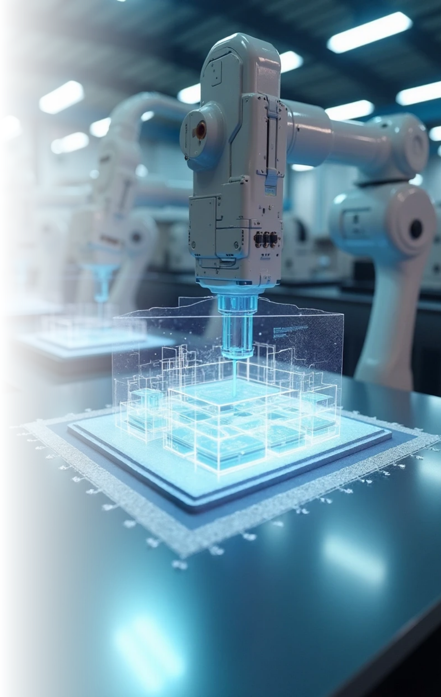
Purpose
Enable secure, automated, and intelligent control of a molding station with live data sharing to a 3D model.

Slide 7





Key Features:
1
2
3
Environmental Monitoring: temperature, humidity, air quality, light
Machine Health Monitoring: RPM, vibration, voltage, current, power
Energy Management: fan/heater status
4
5
6
Secure Access Control: RFID authorization
AGV (Automated Guided Vehicle) tracking using obstacle detector node
3D Digital Twin: real-time visualization and decision feedback

Slide 8

Communication
All nodes transmit sensor data to a central Cloud platform called ThingsBoard enabling bi-directional control.

Slide 9

03
Node Architecture

Slide 10
Node Architecture
Node | Function | Controller | Key Sensors | Key Actuators
1. Access Control System | Manages secure entry using RFID | ESP32 Dev Board | RC522 RFID Reader | Servo motor, Buzzer, Red/Green LEDs
2. Environmental Monitoring | Tracks temperature, humidity, air quality, and light | ESP32 Dev Board | DHT11, MQ135, LDR | LED, Buzzer
3. Energy Management | Monitors device status (heater, fan, light) | ESP32 Dev Board | INA219, Push Button | Incandescent Bulb, Heater, DC Motor (fan), 16×2 LCD, Relay
4. Motor Monitoring | Monitors RPM, temperature, V/I, motor diagnostics | ESP32 Dev Board | INA219, MLX90614, Photoelectric Speed Sensor | DC Motor, Servo Motor, Solid State Relay, 1.3″ OLED, Green LED
5. Lathe Monitoring | Tracks vibration, and power | ESP32 Dev Board | INA219, VL6180X, Piezoelectric Sensor | LR7843 MOSFET, DC Motor, 1.3″ OLED, LED, Buzzer, SG90 Servo
6. Motion Detector | Detects movement near the entry door | ESP32 Dev Board | PIR Motion Sensor | Servo Motor, Green LED
7. Obstacle Detector | Detects AGV movement or obstruction | ESP32 Dev Board | Ultrasonic Sensor HC-SR04 | Buzzer, Red LED
8. Temperature Control | Measure the room temperature | ESP32 Dev Board | LM35 | 5V DC Fan, Relay, Red LED

Slide 11

04
Functional Workflow

Slide 12
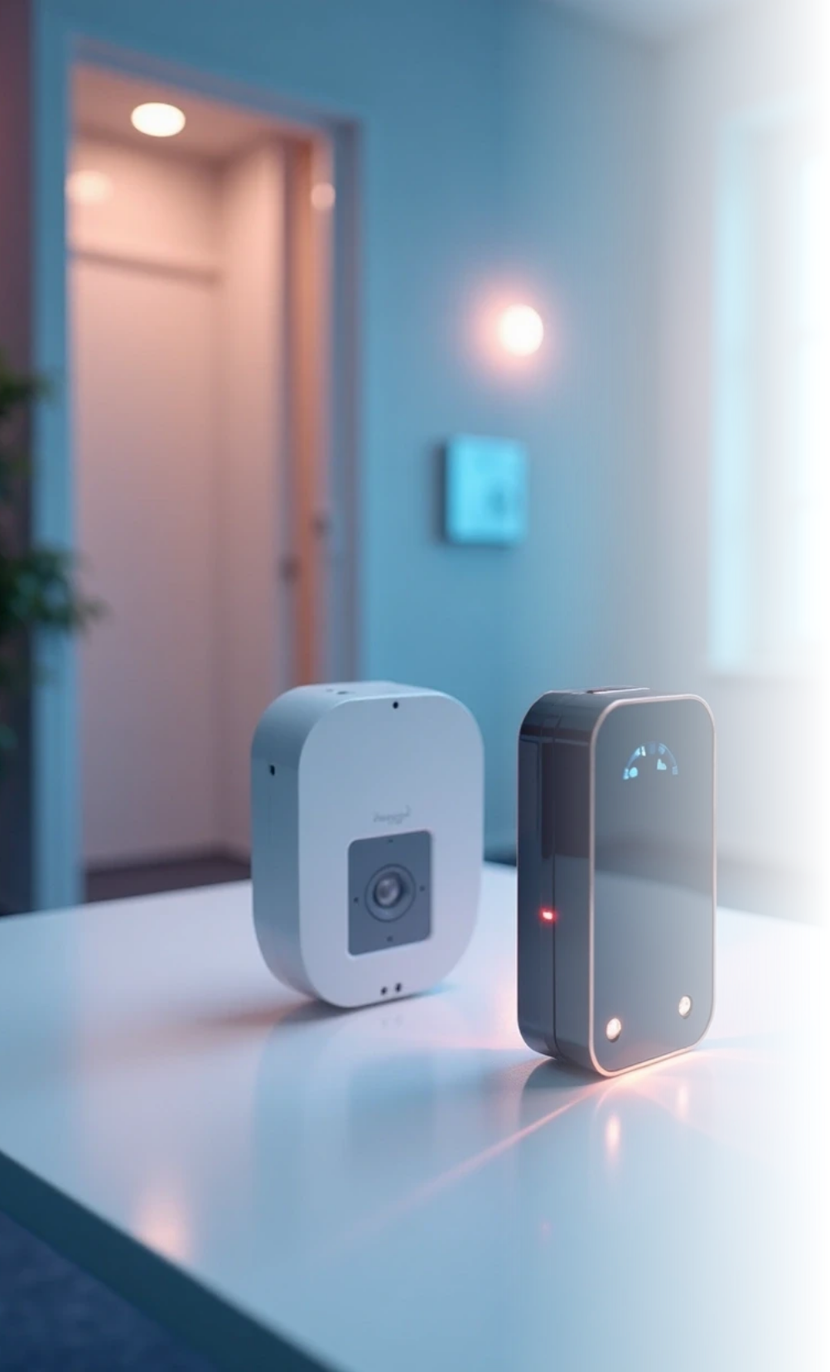
Entry Authorization
The Access Control System authenticates the user via RFID. The Motion Detector confirms physical presence. The Obstacle Detector checks for AGV movement near the door.

Slide 13
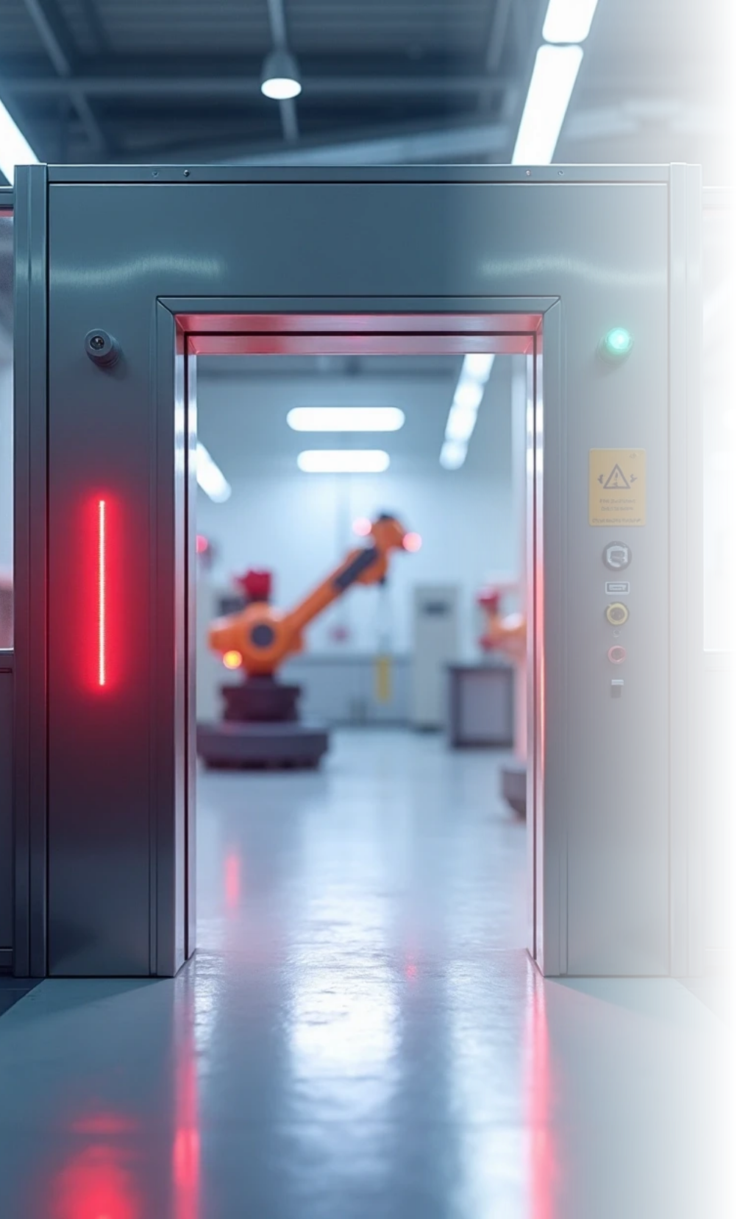


Access Logic
Entry is permitted only if:
1
RFID credentials are valid
2
No AGV/robotic arm is in the doorway
3
All environmental and machine parameters are within safe limits
If any condition fails, the servo-controlled door remains locked.

Slide 14

Real-Time Monitoring & Control
Environmental, energy, and machine data stream to the Cloud platform. Nodes respond automatically; for example, if temperature rises, it indicates that the machinery is working inside.

Slide 15
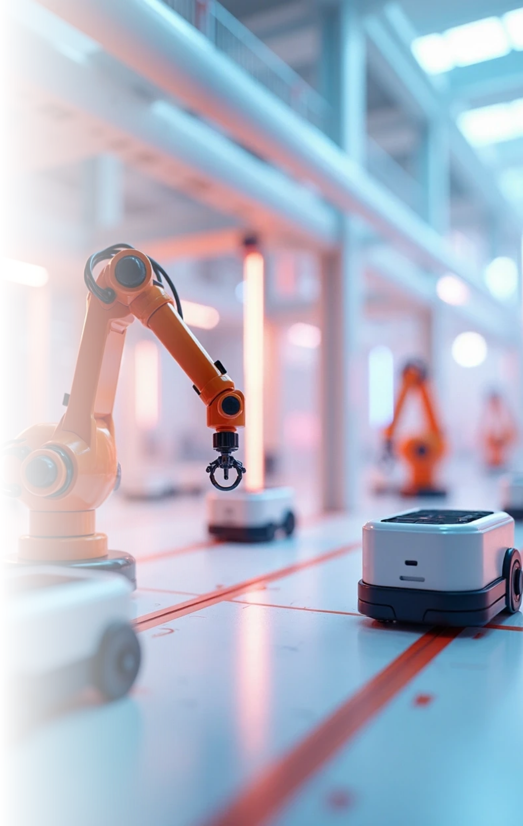
3D Digital Twin
A web-based 3D model mirrors the physical station.
Bidirectional Feedback:
Live sensor data animates the robotic arm, AGV, and door in the 3D model. Commands from the 3D interface can trigger actuators in the real system.

Slide 16

05
Key Features

Slide 17




Key Features
1
2
Safety and Security: Access is conditional on machine status and AGV movement.
Energy Efficiency: Real-time energy tracking optimizes power consumption.
3
4
Predictive Maintenance: Motor and lathe monitoring detect faults before failure.
Scalability: Modular node design allows easy addition of sensors or new stations.

Slide 18
06
Hardware & Software

Slide 19
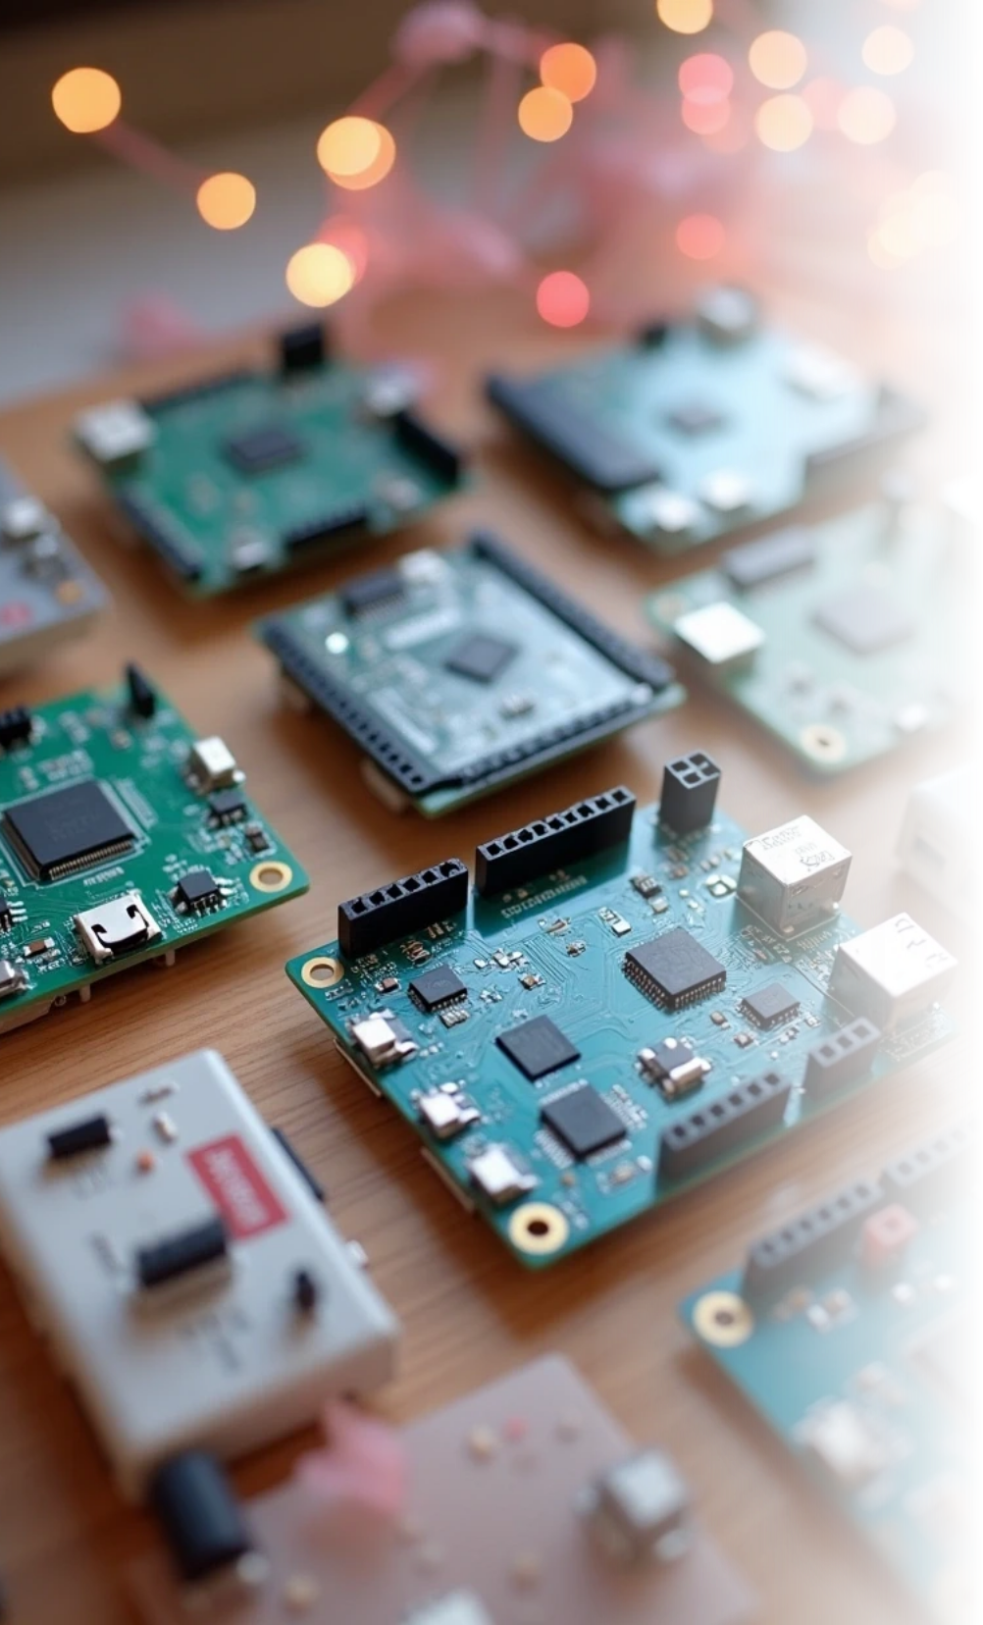
Hardware
ESP32 (multiple variants): ESP8266, ESP32-C6, ESP32-S3, ESP32-WROOM, sensors/actuators as listed above.
Software
Arduino IDE, MQTT, ThingsBoard, Three.js for 3D visualization.
Protocols
Wi-Fi, MQTT, HTTP, Socket.io.

Slide 20

07
Applications

Slide 21
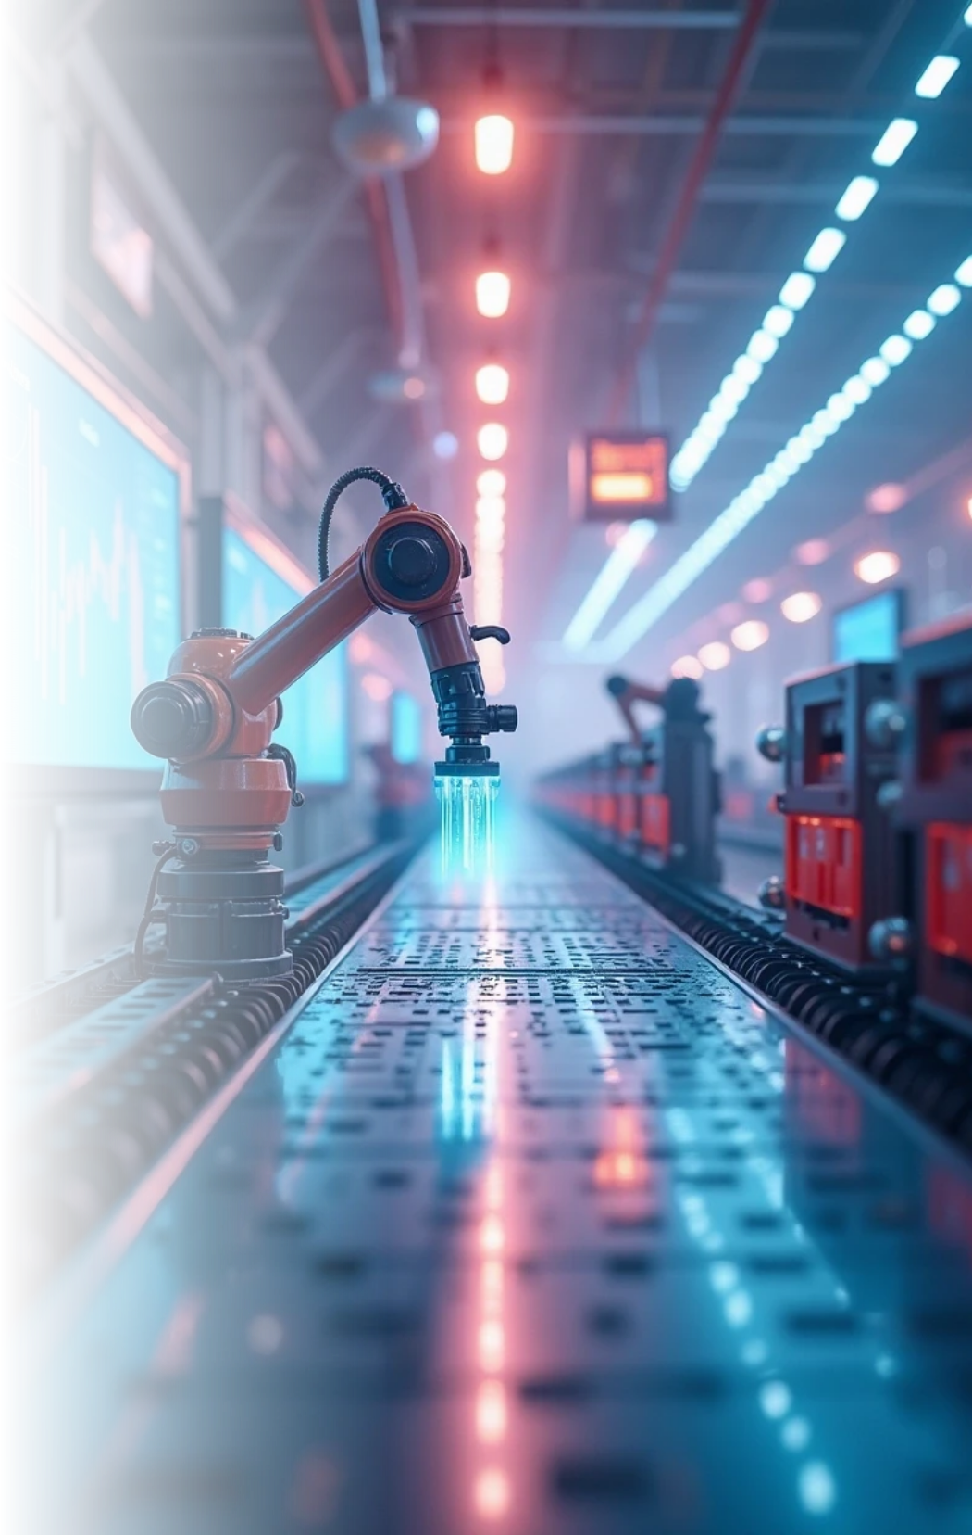


Applications
1
2
Smart manufacturing & Industry
Secure industrial zones
3
4
Energy-aware production floors
Digital twin–based predictive analytics

Slide 22

08
Future Enhancements

Slide 23
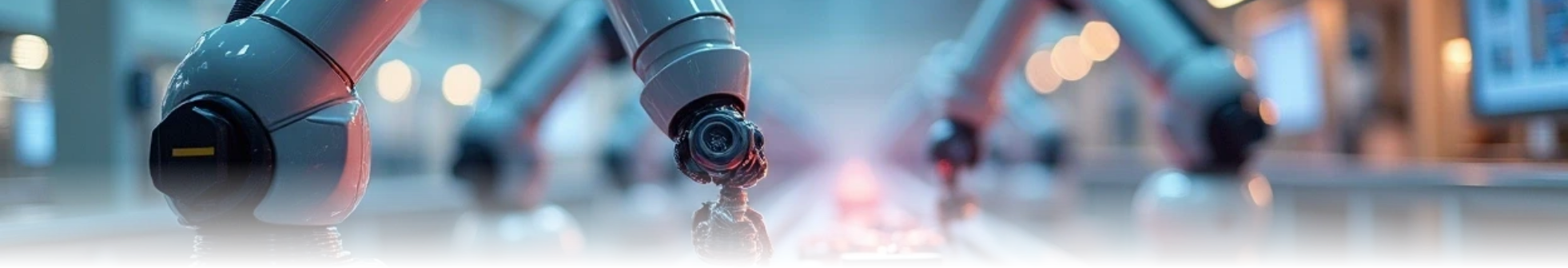



Future Enhancements
1
2
3
AI-driven fault prediction
Edge computing for faster local decision-making
Integration with robotic arms and automated conveyor systems

Slide 24

Thank You

